Slide 1

Presented by: Team L (Alex Stark, Amir Hussain, Bhavan Pahuja, Israa Farouk, Jason Chen) Submitted To: Philmo Gu (Tutorial T02)
CPSC 481 – STAGE 3 PRESENTATION AR MUSEUM APP

Slide 2
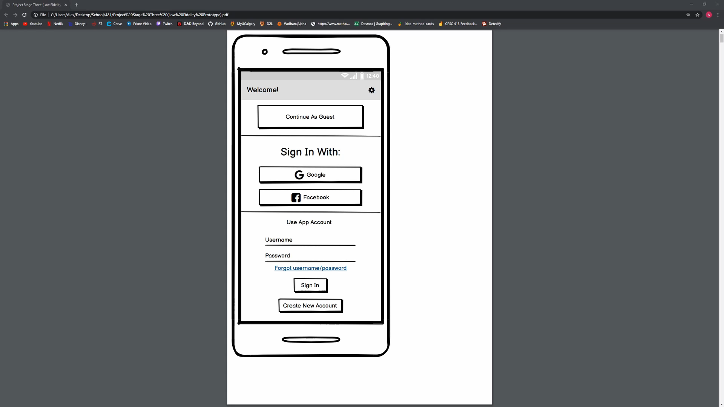
PROTOTYPE DEMO:

Slide 3
STAGE 3 JOURNEY

Slide 4
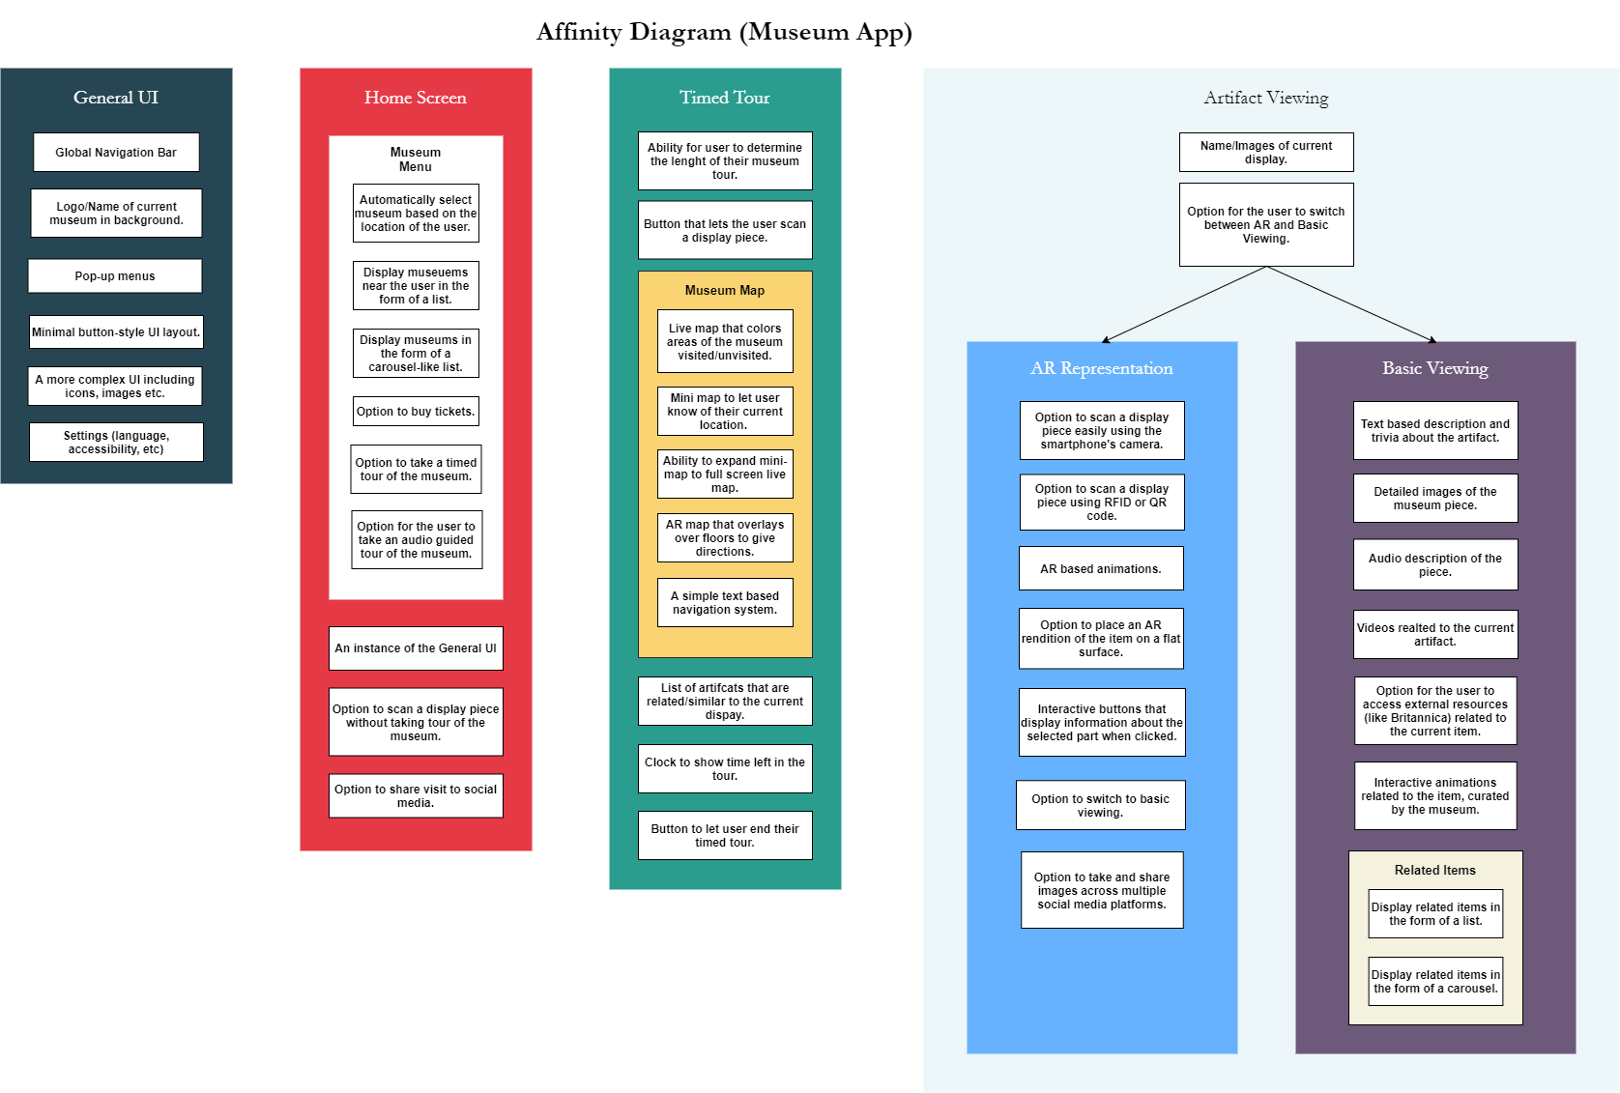

Slide 5
Ideas Ditched:
How we refined our final idea:
Option to scan artifact using RFID/ QR code.
Global navigation bar
Audio guided tour
AR navigation
Compare and evaluate similar ideas.
Ditch the suboptimal ones.

Slide 6
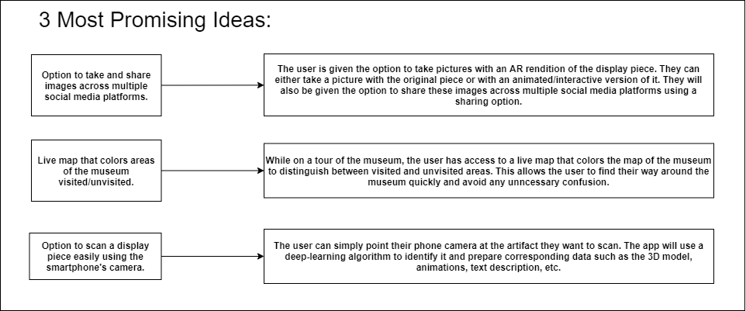
3 Most Promising Ideas:

Slide 7
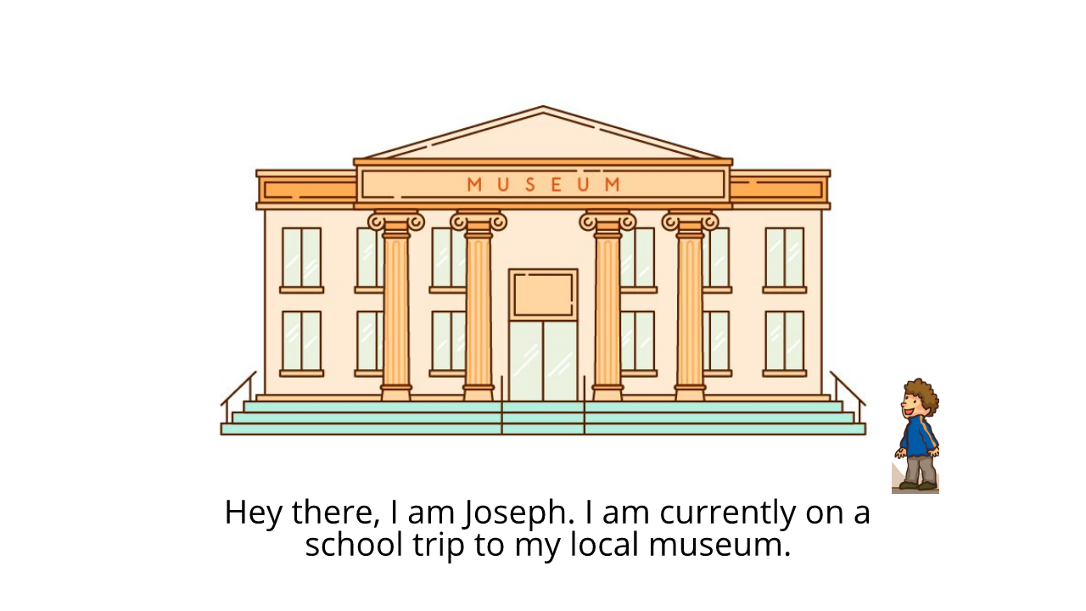
STORYBOARD:
Illustrates how a user would go about taking pictures with an AR rendition of the original display piece or with an animated version of the same. They can also share these images across different social media platforms.

Slide 8
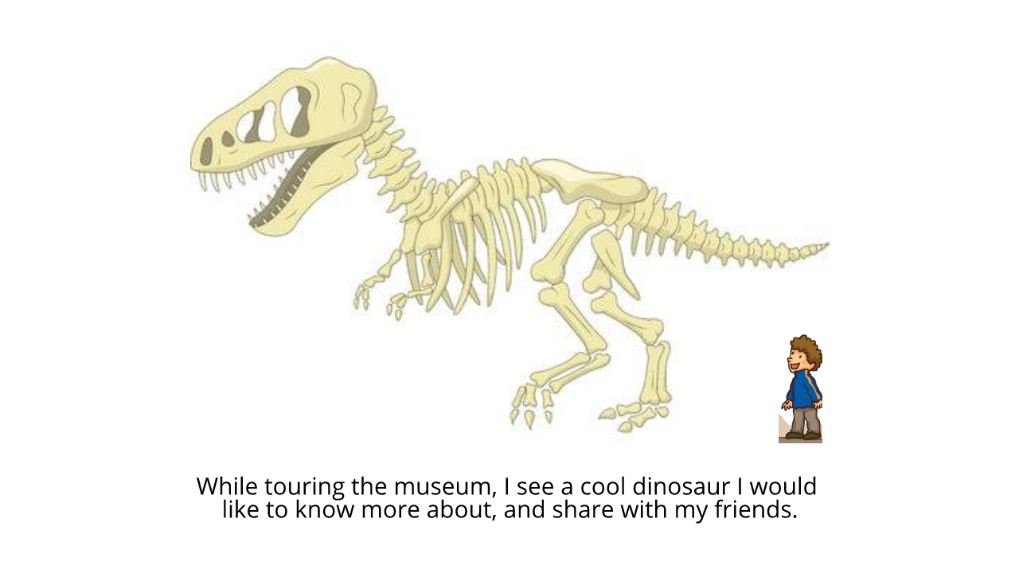

Slide 9
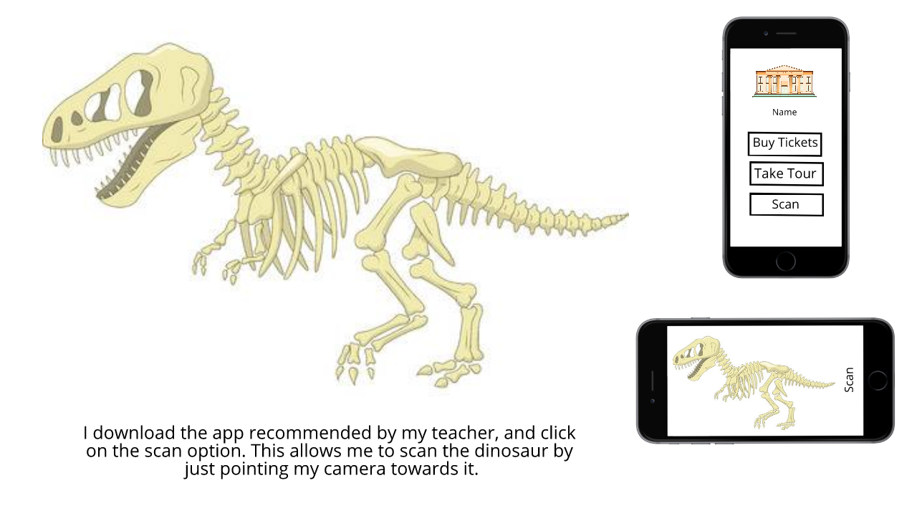

Slide 10
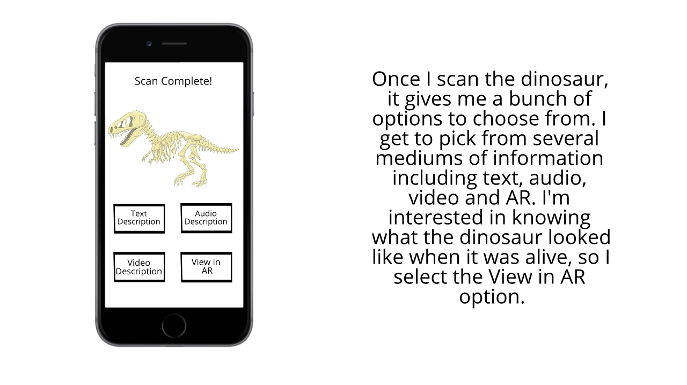

Slide 11
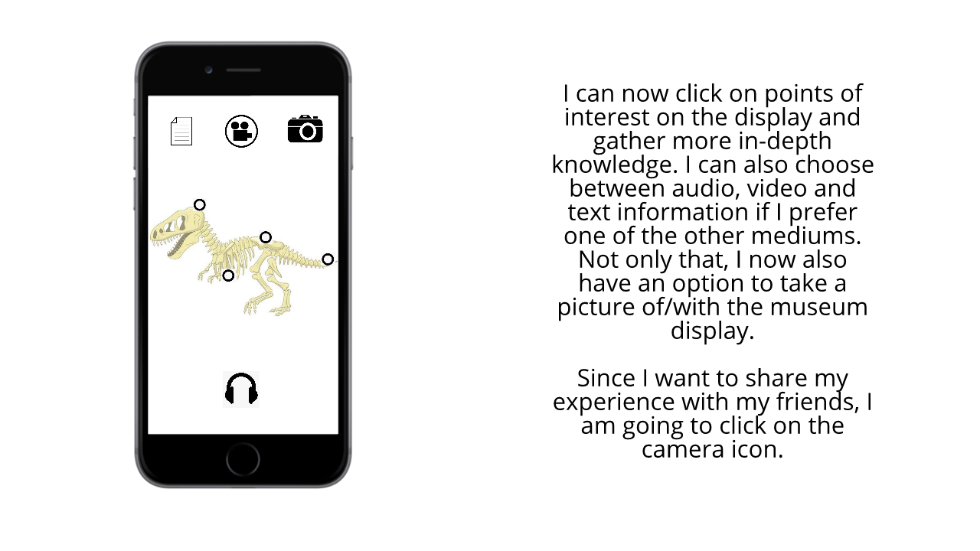

Slide 12
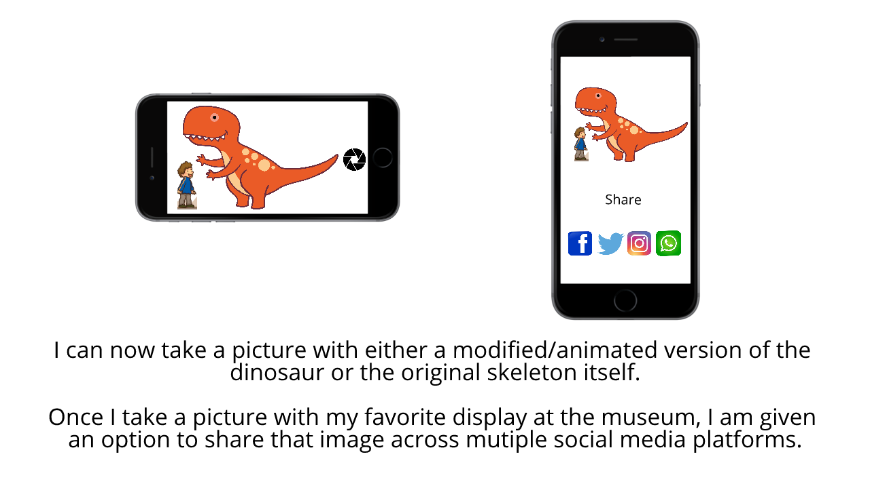

Slide 13

STORYBOARD:
Illustrates how a user would go about taking pictures with an AR rendition of the original display piece or with an animated version of the same. They can also share these images across different social media platforms.

Slide 14
LESSONS LEARNED while creating our Low-Fidelity Prototype
Ease of Prototyping
Due to previous work done
Collaboration on Balsamiq
Use of Balsamiq Cloud
Consistency between components
Efficiency of Design
Use of Screen space & clarity of icons
Flow of Components
Visualization of final product
Notes:
Here are some of the lessons we learned while creating our Lo fidelity prototype
The use of sketches, affinity diagram and storyboard helped us design our low fi prototypes as they acted as a guide.
Our team used Balsamiq to create our prototype and in doing so we all enhanced our skills with it and were able to collaborate efficiently using the cloud feature.
This also helped us maintain consistency between wireframes as we could all follow and look at the conventions we were using like colours button types and so on.
Efficiency of Design – We evaluated our designs on the basis of efficient use of screen space and if icons were clear enough or if text was necessary.
Flow of Components – Creating the prototype made it easy to see how each wireframe linked with each other and if the user could get stuck on any page in particular
Visualization of final product – Lastly designing our prototype gave us a visualization of what the final design of the app would like and is what we will use going forward with the development of our app

Slide 15
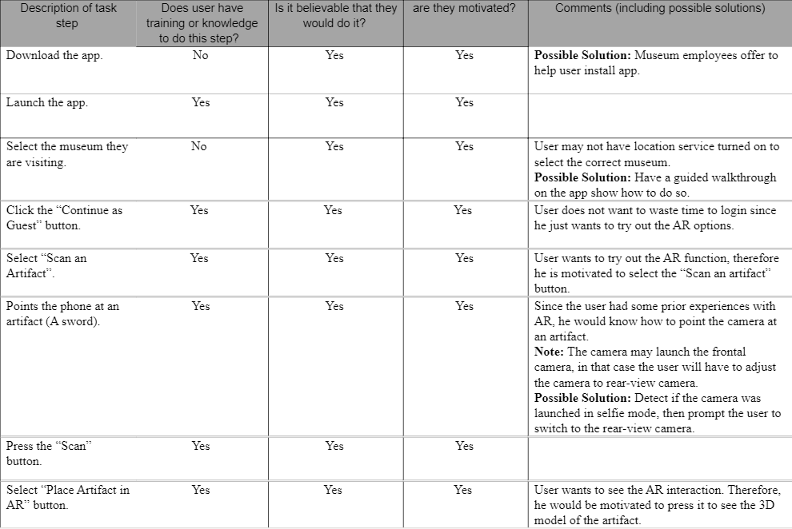
COGNITIVE EVALUATION:
Seeing what out user saw
Lessons learned
Flexibility and variety
Intuitive
User friendly
Room for improvement?

Slide 16
THANKS FOR WATCHING!

